Slide 1





SQL PROJECT ON
MOVIES DATA ANALYSIS
WHERE EVERY FRAME TELLS A STORY
Presented by P. Krishna Chetana Priyanka

Slide 2




ABOUT MOVIES
🎬 Movies have been a big part of entertainment for many years, telling stories that people from different places and cultures enjoy. From old black-and-white films to today’s high-budget blockbusters, the movie industry keeps changing with new technology and creative ideas.
🌟 The movie industry is worth billions and makes thousands of films every year in different languages and styles. Some of the biggest film industries are Hollywood, Bollywood, and regional cinemas, which make movies for different types of audiences.

Slide 3



PROBLEM STATEMENTS
Retrieve a list of unique movie industries along with the count of movies in each industry
Identify movies released after 2010 but show only those with IMDb ratings above 7
Sort movies by IMDb rating but show only the top 10
Identify the shortest and longest movie title length
Top 10 Most Recent Years with Movie Release Counts Movie Release Years with More Than 2 Films and Their Counts
Identify all movies that are in the Hindi language
Identify movies are there in each language
Identify the highest, lowest, and average IMDb ratings of movies produced by Marvel Studios
Movies in each industry, and what is their average IMDb rating
Determine the total revenue of movies grouped by industry
Determine the top 5 actors with the highest number of movie appearances
Movies Featuring Both Chris Hemsworth and Robert Downey Jr.
Identify Actors Who Have Acted in More Than One Language
Determine the top 5 profitable movies in millions considering different currency units

Slide 4
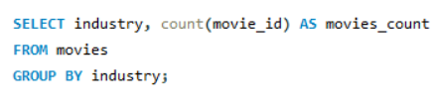
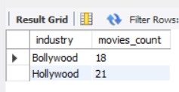



RETRIEVE A LIST OF UNIQUE MOVIE INDUSTRIES ALONG WITH THE COUNT OF MOVIES IN EACH INDUSTRY
PURPOSE
The purpose of this query is to retrieve the number of movies in each industry to analyze which industries produce the most films and identify trends in movie production.

Slide 5
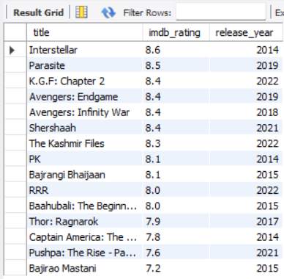
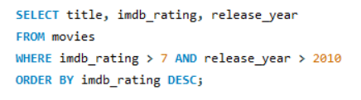
IDENTIFY MOVIES RELEASED AFTER 2010 BUT SHOW ONLY THOSE WITH IMDB RATINGS ABOVE 7
PURPOSE
The purpose of this query is to filter out movies that were released after 2010 and have a high IMDb rating, helping in identifying recent quality films.

Slide 6
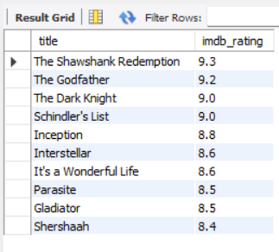
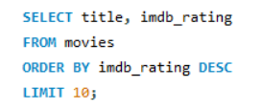
SORT MOVIES BY IMDB RATING BUT SHOW ONLY THE TOP 10
PURPOSE
The purpose of this query is to list the top 10 highest-rated movies, helping in understanding audience preferences and critically acclaimed films.

Slide 7
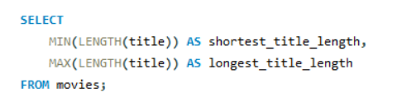
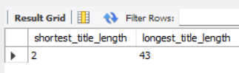
IDENTIFY THE SHORTEST AND LONGEST MOVIE TITLE LENGTH
PURPOSE
The purpose of this query is to analyze movie title trends by identifying the shortest and longest movie titles, which can help in studying naming conventions in films.

Slide 8
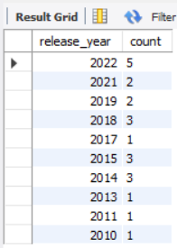
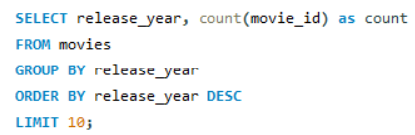
TOP 10 MOST RECENT YEARS WITH MOVIE RELEASE COUNTS
PURPOSE
The purpose of this query is to identify the years with the highest number of movie releases in recent times. This helps in tracking industry growth and identifying peak production years.

Slide 9
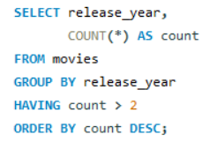
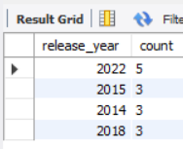
MOVIE RELEASE YEARS WITH MORE THAN 2 FILMS AND THEIR COUNTS
PURPOSE
The purpose of this query is to find years where multiple movies were released. This helps in understanding industry trends and analyzing which years had higher movie production.

Slide 10
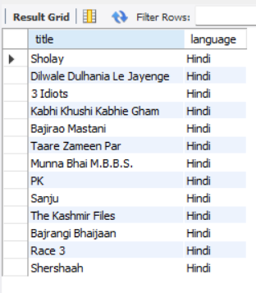
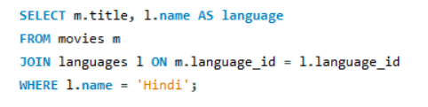
IDENTIFY ALL MOVIES THAT ARE IN THE HINDI LANGUAGE
PURPOSE
The purpose of this query is to extract a list of movies produced in the Hindi language. This helps in analyzing the contributions of the Hindi film industry and understanding its growth.

Slide 11
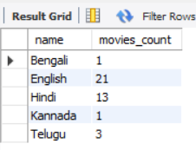
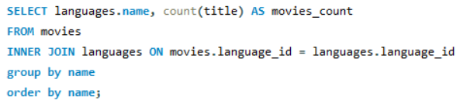
IDENTIFY MOVIES ARE THERE IN EACH LANGUAGE
PURPOSE
The purpose of this query is to retrieve the number of movies available in different languages. This helps in understanding linguistic diversity in the movie industry.
Notes:
12

Slide 12
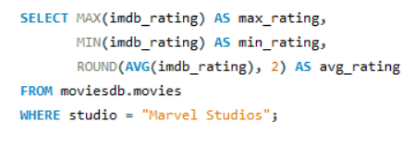
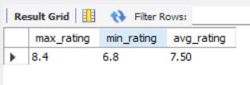
IDENTIFY THE HIGHEST, LOWEST, AND AVERAGE IMDB RATINGS OF MOVIES PRODUCED BY MARVEL STUDIOS
PURPOSE
The purpose of this query is to evaluate the performance of Marvel Studios movies in terms of IMDb ratings. This helps in analyzing audience reception and determining the studio’s success rate.

Slide 13
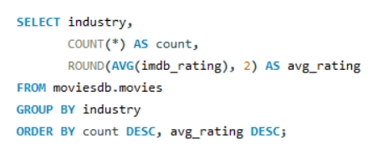
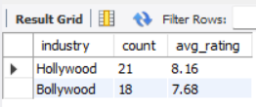
MOVIES IN EACH INDUSTRY, AND WHAT IS THEIR AVERAGE IMDB RATING
PURPOSE
The purpose of this query is to compare different movie industries based on their average IMDb ratings. This helps in assessing the overall quality and reception of movies from each industry.

Slide 14
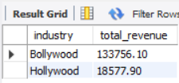
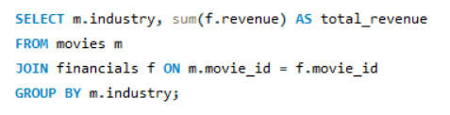
DETERMINE THE TOTAL REVENUE OF MOVIES GROUPED BY INDUSTRY
PURPOSE
The purpose of this query is to analyze the total revenue generated by movies in different industries. This helps in comparing financial performance across industries.

Slide 15
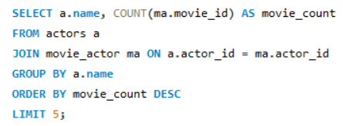
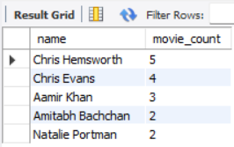
DETERMINE THE TOP 5 ACTORS WITH THE HIGHEST NUMBER OF MOVIE APPEARANCES
PURPOSE
The purpose of this query is to retrieve the list of actors who have appeared in the most movies. This helps in understanding which actors are most in demand.

Slide 16
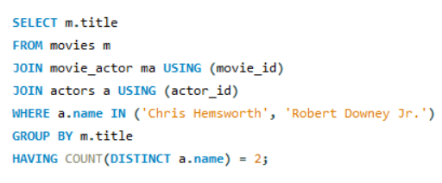
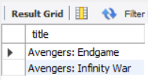
MOVIES FEATURING BOTH CHRIS HEMSWORTH AND ROBERT DOWNEY JR.
PURPOSE
The purpose of this query is to find movies where Chris Hemsworth and Robert Downey Jr. have acted together. This helps in analyzing collaborations between popular actors.

Slide 17
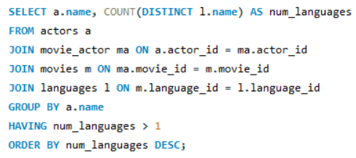
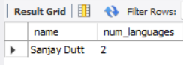
IDENTIFY ACTORS WHO HAVE ACTED IN MORE THAN ONE LANGUAGE
PURPOSE
The purpose of this query is to retrieve a list of actors who have worked in multiple languages. This helps in understanding their versatility and impact across different film industries.

Slide 18
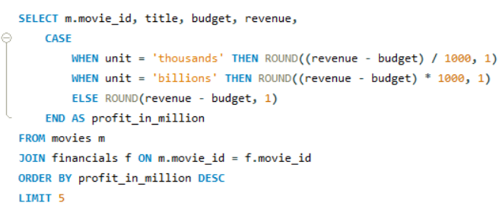
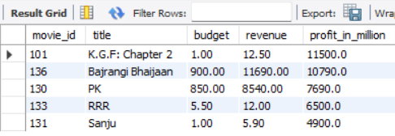
DETERMINE THE TOP 5 PROFITABLE MOVIES IN MILLIONS CONSIDERING DIFFERENT CURRENCY UNITS
PURPOSE
The purpose of this query is to identify the top 5 most profitable movies while considering different currency conversions. This helps in analyzing box office success on a global scale.

Slide 19

THANK YOU

